Slide 1

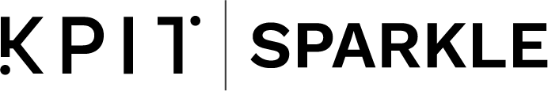
Project Title :AC BULB CONTROL
Sparkle ID: SP21C004326
Team Members: NONE[only one person]
2022
sparkle.kpit.com

Slide 2
Guidelines:
This is the template of your idea evaluation presentation
Students should create final presentation with the help of this template
Make sure your PPT should not exceed more than given title slides i.e. 7 slides
The teams will be evaluated on the ASSURED framework, proposed by Dr. Raghunath Mashelkar
The Next slide is the first slide of your PPT, only use headings for the slides, remaining data is for your help
Your slide should not be content heavy, try to use bullet points or graphics to explain
Font size of title should be 32 and font size of text should be 18
What’s the ASSURED framework? – Watch this video- https://youtu.be/2aZIYuuaVlM
Affordability- Affordability of the product/ service to the common man(10fold less cost)
Scalability – Speed at which the Idea can reach 1 million customers, a brief plan should be presented during the evaluation, should touch the lives of maximum.
Sustainability – Not Limited by Economic supports could be from policies, influencing factors e.g., environmental issues being solved, etc. Standalone, socially acceptable.
Universal- it should be user-friendly with minimal friction with consumers and customers. Maintenance free etc.
Rapid- Speed not limited to getting funds but also implementing on ground.
Excellence- Is this the next practice, in business / technology (best is not enough).
Distinctive- Is it the first for the world, why is it not imitation/ me too idea.

Slide 3
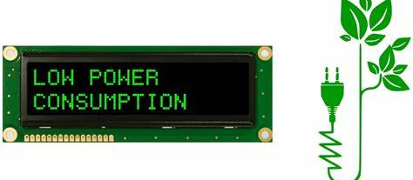

Background & Problem Statement
MAJOR ASPECTS
In this era, as technology swells up, electricity consumption has increased vastly, one of major usage of electrical components is AC light bulb.
To reduce it ,we have to control the bulb in the low power consumption manner.
Last but not least, The project should be impoverished.
I am trying to solve Electricity Exploitation.
I perform need analysis by collecting news ,issues and report
on electricity bill.
The problem is severe ( wastage in both money and electricity).
It is a market driven solution. This idea is for better future

Slide 4
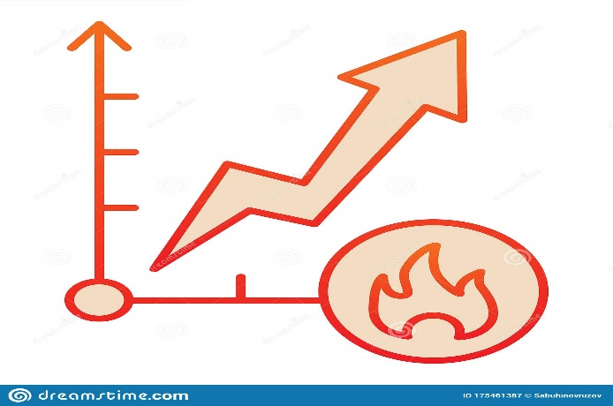

Solution
This project is comprises of Arduino, LDR(light dependent resistor,
IR receiver and remote, relay(5V), AC bulb.
All this components hardly cost.
Quality and life time of the materials are commending.
Key process in this project is that bulb can be controlled by multiple
modes and efficiently.
This project is market driven.
Life cycle of this prototype is depends on the maintenance of the
customer
Key process is that control is given to the customer itself and my aim is
to make them realize the importance of the electricity and awareness
towards it

Slide 5
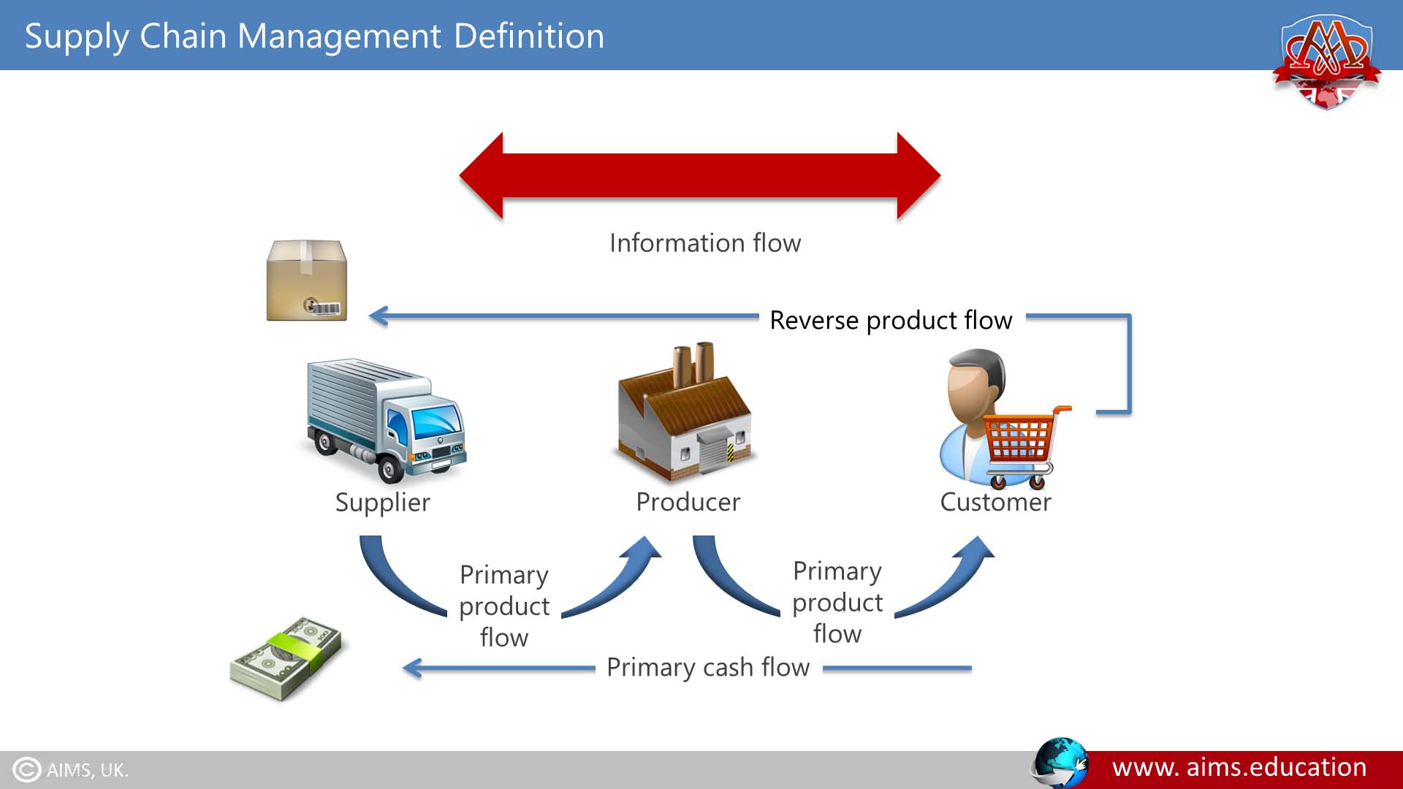
Innovation
In this modern world, we are already using a controlling the bulb using switches but to innovate that, I make the bulb control in the automatic way of use.
By implementing this project/ idea, it becomes a win-win situation for manufacture and customer. I mentioned in the sense electricity usage will be reduce by automating the home and abundant reach will profit the manufacture.
As electricity exploitation drops down in each home, it will lead to sustainable environment for humans.
All the employees will have scalability when it comes to savings. Such resilience can be narrowed by implementing this project.
Sequel of this project will spare the earnings of the customers
and the electricity for upcoming generation.
As materials required are affordable, the producer will
find the material with ease from the supplier and customer
will get the finished goods at competitiveness.

Slide 6
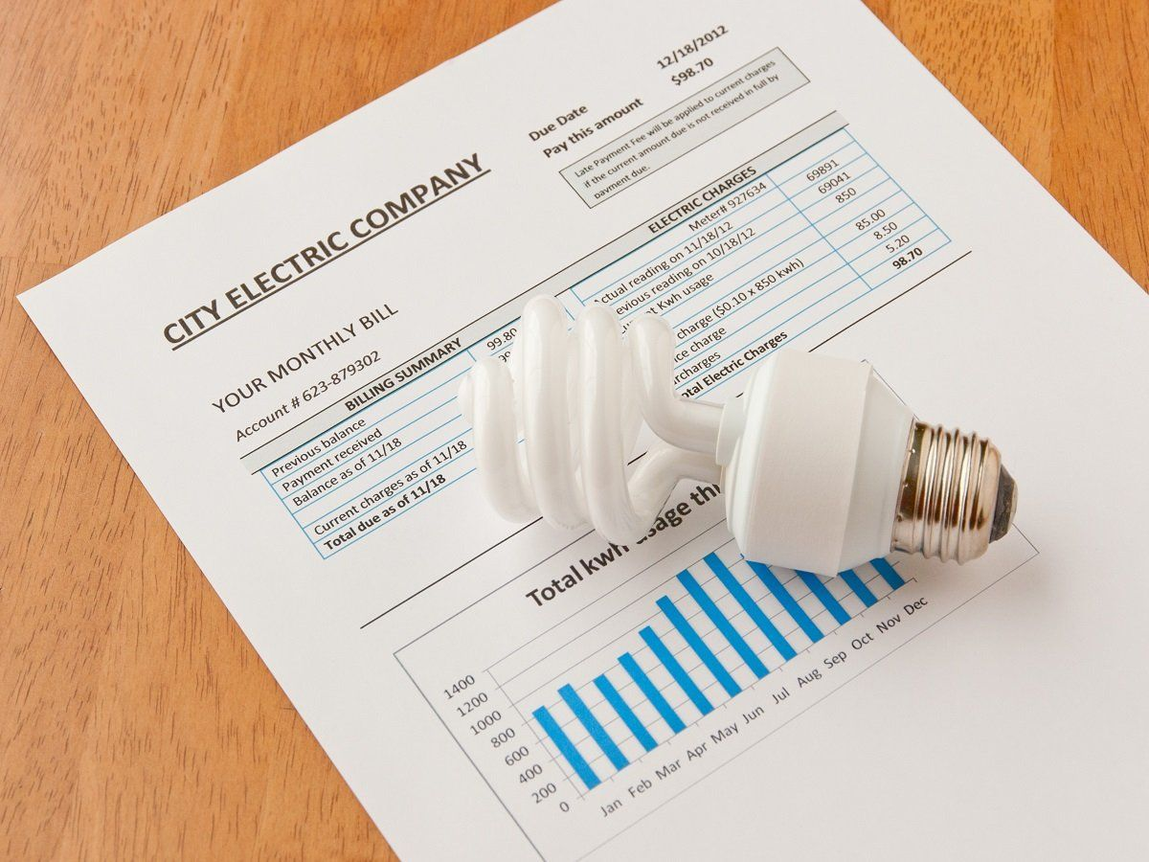
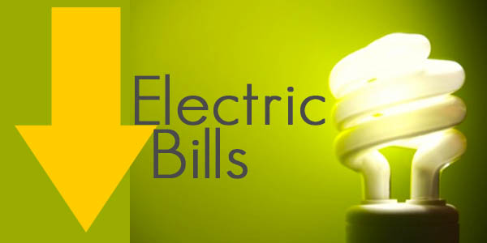
Customer Value Proposition
In this pandemic situation, many people made accusation the TNEB for the escalation of electricity bills but it is still within the reach.
As one of the them, I thought this idea/project to propose to the people who are all in the same tight corner situation as me.
This project is irrespective for better or for worse.
Customer can implement this project because once it is implemented they can see the electricity usage drop.

Slide 7
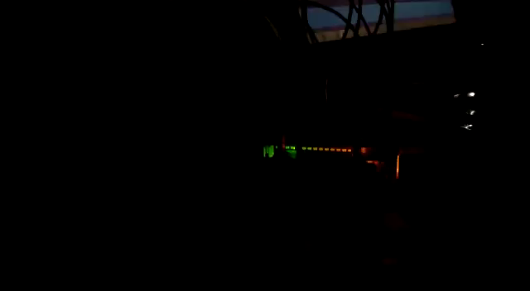
Description of your prototype/simulation
BULB CONTROL (USING MULTIPLE MODES:
In this project/idea, we can control AC bulb using two modes.
Mode 1 is just controlling AC bulb using IR remote.
Mode 2 will be controlling AC bulb in accordance
with LDR( Light Dependent Resistor).
Required components :
AC supply.
Male to female wire plug.
LDR, IR remote and receiver .
Jumper wires.
AC light bulb.
220 ohm resistor.
Arduino and breadboard.
Relay (5V).
NOTE: I used IR remote to choose the mode of operation. So it is not like I copied anyone’s idea or project. Of course someone did but only separately just to innovate I combined those two mode of operation.

Slide 8
Market Potential:
it is a business to customer type of business.
Market size will be 10,000.
My main target customer is one who is in middle class family because in this pandemic, they are able to pay
the electricity bill as TNEB took reading for the duration of four months straight.
If by any chance failure occurs, we can make alternative by replacing the remote or making the mode selection
using internet.
If everyone liked and implement this, then we can tend to start the sustainable environment.
If possible since it is affordable, many will start to innovate more and more in this field.
My own innovation will be including another mode to switch ON and OFF the AC bulb in accordance with
Distance/ultrasonic sensor.

Slide 9
Current status:
Yes, of course prototype is ready but needed specific design and to make more and more elegant.
Field testing with end user and full fledged prototype can be done in 1 month.
My own perception is to advertise this product to attract people.

Slide 10


